Slide 1
Symbolic Knowledge Representation
Lyernisha s r
Lecturer, fict

Slide 2
Knowledge Representation fundamental Terminologies
Data is unprocessed facts and figures without any added interpretation or analysis. It is unstructured or raw
Information is data that has been interpreted so that it has meaning for the user. In short, structured/processed data is information.
Metainformation is information about information.
For example, a if a document is considered to be information, its title, location, and subject are examples of metainformation.
Knowledge is a more “processed” version of information.
Meta-knowledge is knowledge about a preselected knowledge. (knowledge about knowledge)
A book on the shelf is information — until a person reads it, understands it, and absorbs it. Then (and only then) it has been converted into that person’s knowledge. (When the person subsequently socializes that knowledge and applies it to make decisions and/or take actions, then it has become intelligence.)

Slide 3
What To Represent ?
Following are the various fields of knowledge which needs to be represented in AI systems.
Object: All the facts about objects in our domain world. E.g., Guitars contains strings, trumpets are brass instruments.
Events: Events are the actions which occur in our domain world.
Performance: It describe behavior which involves knowledge about how to do things. How it respond and act or how efficiently it reacts.
Meta-knowledge: It is knowledge about the all the knowledge that we consider in our domain.
Facts: Facts are the truths about the real world and the domain what we represent.
Knowledge-Base: The central component of the knowledge-based agents is the knowledge base. It is represented as KB. The Knowledgebase is a group of the Sentences (Here, sentences are used as a technical term – (NLP )and not identical with the English language).
Natural language processing (NLP) is the relationship between computers and human language. More specifically, natural language processing is the computer understanding, analysis, manipulation, and/or generation of natural language

Slide 4
Symbolic AI
Symbolic AI
Symbolic artificial intelligence is also known as Good, Old-Fashioned AI (GOAI)
Implementations of symbolic reasoning are called rules engines or expert systems or knowledge graphs.
These systems are essentially heaps of nested if-then statements drawing conclusions about entities (human-readable concepts) and their relations (expressed in well understood semantics like X is-a man or X lives-in America)
The symbolic approach says that the best way to teach an AI is to feed it human-readable information related to what you think it needs to know. If you want to create an AI to replace a doctor, you feed it a ton of medical textbooks and it answers questions by looking up the answers from those textbooks

Slide 5
In Symbolic AI , all steps are based on symbolic human readable representations of the problem and use logic and search to solve problem.
Key advantage of Symbolic AI is that the reasoning process can be easily understood – a Symbolic AI program can easily explain why a certain conclusion is reached and what the reasoning steps had been.
A key disadvantage of Symbolic AI is that for learning process – the rules and knowledge has to be hand coded which is a hard problem.
Symbolic Knowledge Representation:
1.Production Rules
2. Logical Representation
3.Semantic Net
4.Frames

Slide 6
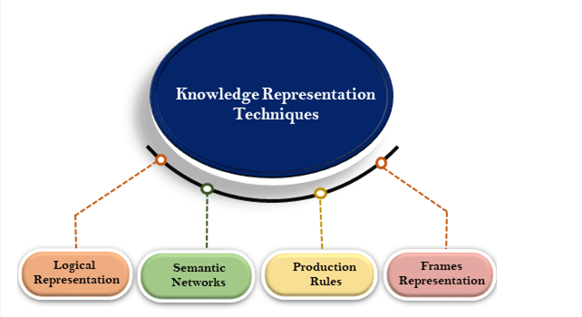
SYMBOLIC KNOWLEDGE REPRESENTATION TECHNIQUES

Slide 7
Production Rules
Production rules system consist of (condition, action) pairs which mean, "If condition then action". It has mainly three parts:
1.The set of production rules
2.Working Memory
3.new situation
1. In production rules agent/system checks for the condition and if the condition exists then production rule fires and corresponding action is carried out. The condition part of the rule determines which rule may be applied to a problem. And the action part carries out the associated problem-solving steps. This complete process is called a recognize-act cycle.
2. The working memory contains the description of the current state of problems 3.The recognize-act-cycle
and events which are solving. Rules can write knowledge (update) to the working memory. This knowledge match and may fire other rules.
3. If there is a new situation (state) generates, then multiple production rules will be fired together, this is called conflict set. In this situation, the agent/system needs to select a rule from these sets, and it is called a conflict resolution.

Slide 8
Production Rules
EXAMPLE:
IF (at bus stop AND bus arrives) THEN action (get into the bus)
IF (on the bus AND paid AND empty seat) THEN action (sit down).
IF (on bus AND unpaid) THEN action (pay charges).
IF (bus arrives at destination) THEN action (get down from the bus).
Advantages of Production rule:
The production rules are expressed in natural language.
Each rule define a small and independent piece of knowledge.
The production rules are highly modular, so we can easily remove, add or modify an individual rule.
New rules may be added and old ones deleted
Rules are usually independent of other rules.
Disadvantages of Production rule:
Production rule system does not exhibit any learning capabilities, as it does not store the result of the problem for the future uses.
During the execution of the program, many rules may be active hence rule-based production systems are inefficient
Note: The production rules as knowledge representation mechanism are used in the design of many "Rule-based systems" also called "Production systems" .

Slide 9
Logical Representation
Logical representation is a language with some concrete rules which deals with propositions and has no ambiguity in representation.
Logical representation means drawing a conclusion based on various conditions. This representation lays down some important communication rules.
It consists of precisely defined syntax and semantics which supports the sound inference.
Each sentence can be translated into logics using syntax and semantics.

Slide 10
Logical representation can be categorised into mainly two logics:
Propositional logics
Predicate logics

Slide 11
First order logic/Predicate logic
The main connective for universal quantifier ∀ is implication →.
The main connective for existential quantifier ∃ is and ∧.
All birds fly. ∀x bird(x) →fly(x).
Lily is tall. tall(Lily)
Lily likes bananas. likes(Lily, bananas)
Lily likes bananas and oranges. likes(Lily, bananas) ∧ likes(Lily,oranges)
Lily likes bananas but not apples. likes(Lily, bananas) ∧ ¬likes(Lily,apples).
Every man respects his parent. ∀x man(x) → respects (x, parent).
Some boys play cricket. ∃x boys(x) → play(x, cricket).
Not all students like both Mathematics and Science. ¬∀ (x) [ student(x) → like(x, Mathematics) ∧ like(x, Science)].

Slide 12
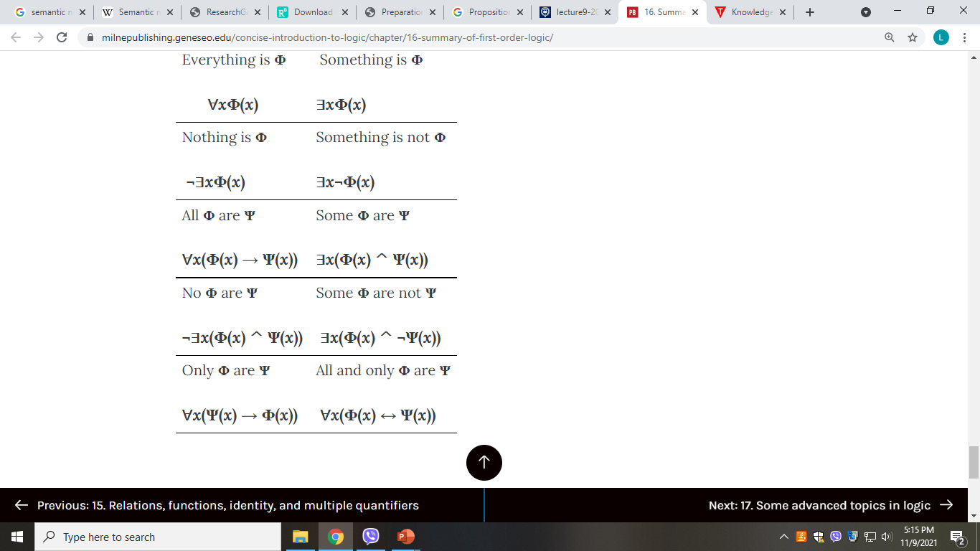
Some advice on translations using quantifiers

Slide 13
Advantages of logical representation:
Logical representation enables us to do logical reasoning.
Logical representation is the basis for the programming languages.
Disadvantages of logical representation:
Logical representations have some restrictions and are challenging to work with.
Logical representation technique may not be very natural, and inference may not be so efficient.

Slide 14
UNCERTAINTY
With this logical knowledge representation, we might write A→B, which means if A is true then B is true, but consider a situation where we are not sure about whether A is true or not then we cannot express this statement, this situation is called uncertainty.
Causes of uncertainty
Following are some leading causes of uncertainty to occur in the real world
Information occurred from unreliable sources.
Experimental Errors
Equipment fault
Temperature variation
Climate change
Logical statements are expressed in terms of truth or falsehood—it is not possible to reason, in classical logic, about possibilities.
One of the main weaknesses of traditional logic is its inability to deal with uncertainty.
So to represent uncertain knowledge, where we are not sure about the predicates, we need uncertain reasoning or probabilistic reasoning.

Slide 15
Semantic Network Representation
Semantic networks are alternative of predicate logic for knowledge representation.
In semantic networks, we can represent our knowledge in the form of graphical networks.
This network consists of nodes representing objects and arcs which describe the relationship between those objects.
Semantic networks can categorize the object in different forms and can also link those objects. Semantic networks are easy to understand and can be easily extended.

Slide 16
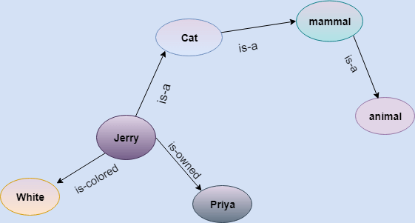
Semantic Network Representation
Example: Following are some statements which we need to represent in the form of nodes and arcs.
Statements:
Jerry is a cat.
Jerry is a mammal
Jerry is owned by priya.
Jerry is white colored.
All mammals are animal.

Slide 17
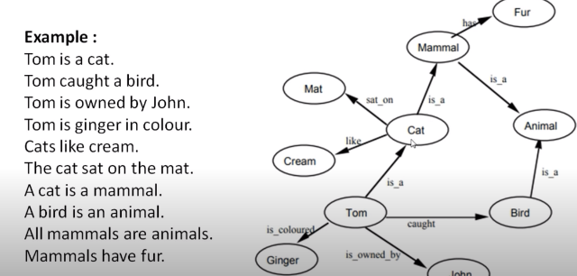
EXAMPLE

Slide 18
Try
Handle is a part of automobile.
Body is a part of automobile.
Tire is a part of automobile.
Brake is a part of automobile.

Slide 19
Drawbacks in semantic representation:
Semantic networks take more computational time at runtime as we need to traverse the complete network tree to answer some questions. It might be possible in the worst case scenario that after traversing the entire tree, we find that the solution does not exist in this network.
Semantic networks try to model human-like memory (which has 1015 neurons and links) to store the information, but in practice, it is not possible to build such a vast semantic network.
These types of representations are inadequate as they do not have any equivalent quantifier, e.g., For all, for some, none, etc.
Semantic networks do not have any standard definition for the link names.
These networks are not intelligent and depend on the creator of the system.
Advantages of semantic network:
Semantic networks are a natural representation of knowledge.
Semantic networks convey meaning in a transparent manner.
These networks are simple and easily understandable.

Slide 20
Frame Representation
A frame is a record like structure which consists of a collection of attributes and its values to describe an entity in the world.
Frames are the AI data structure which divides knowledge into substructures by representing stereotypes situations.
It consists of a collection of slots and slot values. These slots may be of any type and sizes. Slots have names and values which are called facets.
A frame is also known as slot-filter knowledge representation in artificial intelligence.

Slide 21
Frame Representation
Let's suppose we are taking an entity, peter. Peter is a doctor as a profession, and his age is 25, he lives in city London, and the country is England. So following is the frame representation for this:
Slots | Filter
Name | Peter
Profession | Doctor
Age | 25
City | London
Country | England

Slide 22
KNOWLEDGE ACQUISITION
Knowledge Acquisition is the transformation of knowledge from the forms in which it exists into forms that can be used in a knowledge based system.
It is a process of adding new knowledge to a knowledge base, refining, improving previously acquired knowledge
Acquisition is usually associated with some definite purpose such as expanding the capabilities of system, improving or enhancing the performance of some specific tasks.
Acquired knowledge consist of facts, rules, concept, procedure, formulas, relationship, stats, plans, heuristic or any relevant information

Slide 23
THREE MODEL OF KNOWLEDGE ACQUISITION
Handcrafting - means coding; knowledge is converted into program directly
Knowledge engineering - means working with expert system to organize knowledge in a suitable form for an expert system to use
Machine learning - means to extract the knowledge from training examples

Slide 24
CHALLENGES/ ISSUES IN KNOWLEDGE ACQUISITION
Most knowledge is in the heads of experts
Experts have vast amount of knowledge
Experts are very busy and valuable people
Each expert doesn't know everything
Knowledge is short lived
Difference in experts opinions
Difficulties in structuring knowledge – Losing a significant amount of knowledge when structuring implicit knowledge
Domain Expert’s unwillingness
– Unavailable
– Uncooperative
– No knowledge of computers and Expert Systems

Slide 25
Thankyou

